Slide 1

DR KV SUBBA REDDY INSTITUTE OF TECHNOLOGY
Wireless Digital notice board using bluetooth
PRESENTED BY
BATCH-4 & BATCH-5
SHAIK ZEBA MEHREEN V. SRIVENI
P. HEMALATHA R. SWATHI PRIYA
P. PAVITHRA B. REVATHI
C. SRAVANI M.RUCHITHA
K. SIVARANI
UNDER THE GUIDENCE OF
DR.S.A.K JILANI
M-TECH , PHD.
PROFESSOR
T.VIJAY KUMAR
M-TECH (PHD)
ASSOCIATE PROFESSOR
T.VIJAY KUMAR

Slide 2
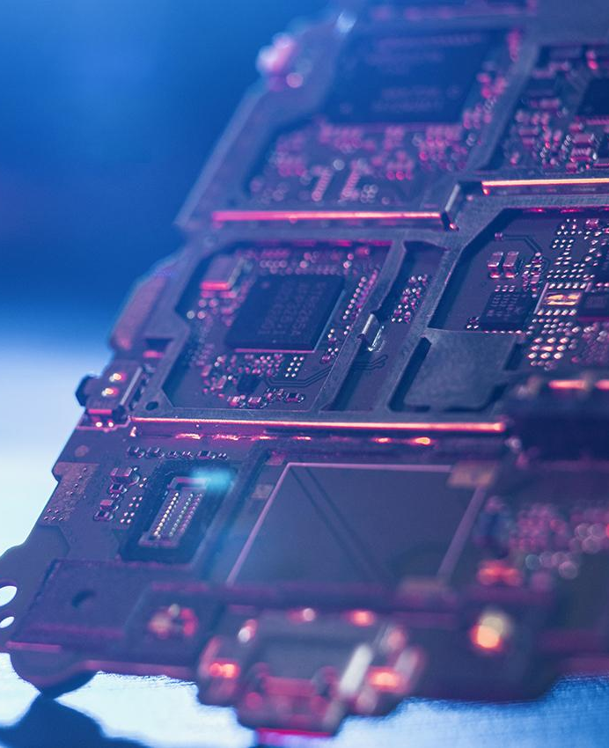
ABSTRACT
Wireless digital notice board display to gather the information on display of LED matrix. This project can be also used in institutions or organization etc. but, sending notices day to day is a heavy process. This project deals with advanced notice board. In Our proposed system the user will enable to transmit notices wirelessly on a notice board using Controller NodeMcu having Wi-Fi Module with smart phone and users get auto notification using cloud. Its operation is based on microcontroller NodeMcu.

Slide 3
CONTENTS
Introduction
Block Diagram
Components
Software
Hardware
Advantages
Disadvantages
Applications
Reference
Conclusion

Slide 4
INTRODUCTION
To realize the proposed digital notice board on cloud platform, we have developed following protoIn this system we can display a message or notice to some display device like LCD, and this message can be easily set or changed from anywhere in the world, just by using the SMS facility of your mobile handset.
type model. It consists of NodeMcu which have in built WiFi Module.
Mobile phone and LED Matrix is used for testing the proposed model. NodeMCU is a firmware that allows you to program the ESP8266 modules with LUA script.
It is very similar to the way you program Arduino. With just a few lines of code you can establish a WiFi connection, control the ESP8266 GPIOs, turning your ESP8266 into a web server and a lot more. The Controller will be connected to the internet through Wi-Fi module.
The user will send the notice through internet from the smart phone. The NodeMcu will read that notice from the internet and display it on the notice board. The data will also be uploaded on cloud and other user will also be connected to the cloud.
This enables the multiple users to operate the digital notice board.

Slide 5
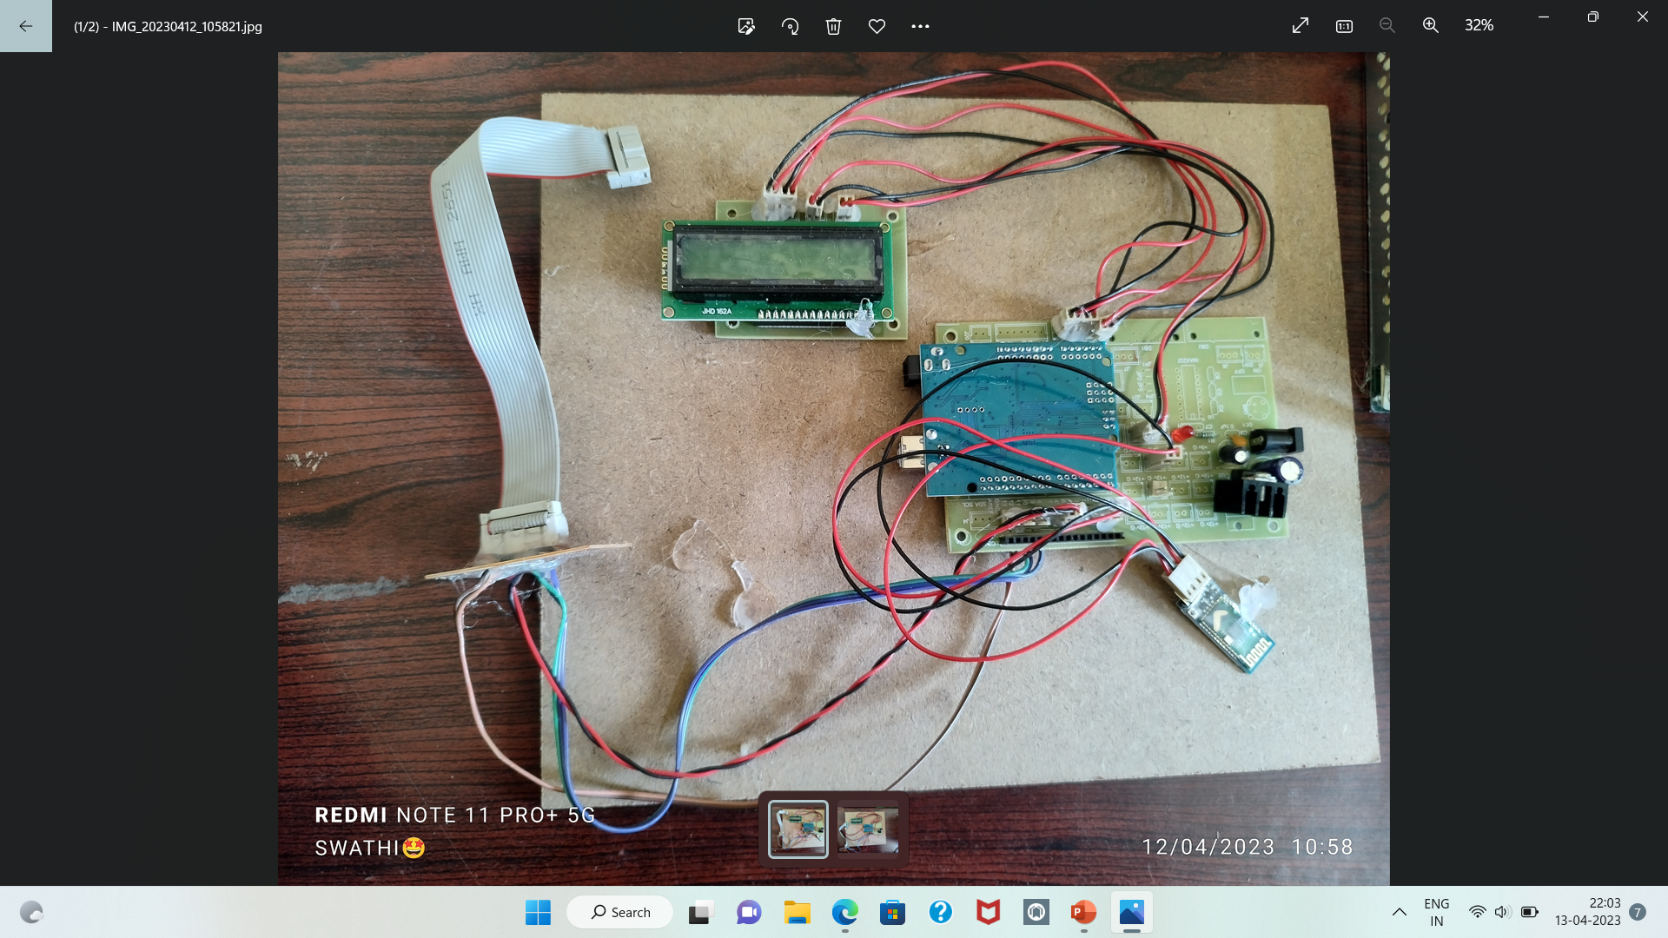

Slide 6
WORKING
In our project we use power supply, Arduino UNO, LED module, Bluetooth HC-05 and mobile
application. After uploading the program in Arduino UNO, we will give them external power supply. Due
to that all functions of equipment’s are on. At that time, we will pass the notice/SMS which we want
using mobile. Then this notice/SMS will receive by Bluetooth. And by using Arduino this notice/SMS will
display on digital notice board.

Slide 7
Block Diagram
POWER SUPPLY
ARDUINO
LED BOARD
BLUETOOTH
LCD
APP

Slide 8
COMPONENTS
ARDUINO UNO R3
LCD (Liquid Crystal Display)
Bluetooth Serial Communication App
SMPS (Switch Mode Power Supply)
LED
Voltage Regulator
RPS Board
Adaptor

Slide 9
ARDUINO IDE
It connects to The Arduino IDE (Integrated Development Environment) Arduino IDE contains a text editor for writing code ,a message area, a text console, a tool bar with buttons for common functions.
he Arduino hardware to upload programs and communicate with them.
Programs written using Arduino software(IDE) are called sketches.
The editor has features for cutting/pasting and for searching/Replacing text.
LCD
The Liquid Crystal Display (LCD) panel is designed to project on screen information of a microcomputer on to a larger screen with the aid of a standard overhead projector, so that large audiences may view on screen information without having to crowd around the TV monitor.
A display is made up of millions of pixels. The quality of a display commonly refers to the number of pixels .

Slide 10
BLUETOOTH SERIAL COMMUNICATION APP
This is the connection point that allows an app to exchange data with another Bluetooth device using input stream and output stream.
When the user sends the notification to the Arduino through cloud other user can also gets the notification on their smartphone.
T
SMPS
A Switch Mode Power Supply are ‘SMPS’ , is an electronic power supply that integrates a switching regulator for efficient electrical power conversion .
Like other supplies, an SMPS transfers power from a DC or AC source to DC loads while converting voltage and current.

Slide 11
ADAPTOR
An Adaptor Is a software component that provides an interface between an application and an integration server.
Adaptor is a device that converts attributes of one electrical device or system to those of an otherwise incompatible device or system.
REGULATOR VOLTAGE
Voltage Regulator , any electrical or electronic device that maintains the voltage of a power source within acceptable limits .
When LED Notice Board produces heavy heat , the voltage regulator will controls the produced Heat.

Slide 12
RPS (Regulated Power Supply)
A Regulated Power Supply is an embedded circuit ; It converts unregulated AC (Alternating Curresnt) into a constant DC (Direct Current) with the help of a rectifier it.
It compares the output voltage with a precise reference voltage and adjust the pass device to maintain a constant output voltage .
LED DISPLAY
A LED Display is a flat panel display that uses an array of Light Emitting Diode as pixels for video display.
Their brightness allows them to be used outdoors where they are visible in the sun for store signs and billboards.

Slide 13
SOFTWARE
It consists of ARDUINO IDE which have in built WiFi Module. Mobile phone and LED Matrix is used for testing the proposed model.
ARDUINO IDE is a firmware that allows you to program the ESP8266 modules with LUA script. It is very similar to the way you program Arduino.

Slide 14
FLOW CHART
Incoming Message
Check for new message
Is the sender’s no. valid ?
Keep displaying the previous message
n
y
Is new message higher in priority ?
Replace old message with new one in memory
Y
Y
Keep displaying the previous message

Slide 15
HARDWARE
It uses a microcontroller for system control, WiFi based technology for communication and sends the message through the android application.
The project consists of a 32-bit ARM based microcontroller LPC2148, WiFi module, an LCD, and an android application for user in- terface with the hardware.

Slide 16
ADVANTAGES
The electronic notice board is wireless and no need for wires for displaying the information on the LCD display.
It is very easy to operate and consumes less power.
The circuit of the wireless notice board is portable.
Cost of system is less.
Cost of printing and photo copying is also reduce as information can be given to a large number of people from our finger tips.
This project saves time, energy.

Slide 17
DISADVANTAGES
Limited Viewing angle and Brightness
It requires an additional light source
Precautions should be taken while the SMPS is connected

Slide 18
APPLICATIONS
The applications of wireless notice board mainly include public places like
Colleges
Bus stands
Railway stations
Airports
Shopping malls and
Parks to display the information wirelessly.
These applications are use By using WLNA such as Wi-Fi, Cell phones, wireless power transfer, computer interface devices, and various wireless communication-based.

Slide 19
REFERENCE
Neeraj kheral, Divya Shukla2, Shambavi “Development of Simple and lowcost Android Based Wireless Electronic Noticeboard “ 2016 5th International conference on Reliability ,Infocom Technologies and optimization(ICRITO)
yash ,Giva.Siva perumal, Radhika Mujumdar, Sridhar Lokanath “Large Screen Wireless Notice Display System “ 2015 International Conference on Computaional Intelligence and computing Research,2015
Dharmendra kumar Sharma, Vineet Tiwari, Krishan Kumar B.A. Botre, S.A. Akbar“Small and medium Range Wireless Electronic Engineering research Institute,Pilani,
Kruthika Simha,Chethan Kumar,Parinitha C,Shashidhar Tantry,”electronic notice boardwidth multiple output display”

Slide 20
CONCLUSION
It is fully involved in using of papers in displaying of notices is avoided and the information can be updated by the every second. It also makes the system compatible with more than one wireless technology.
This project describes the Wi-fi based LED display.
Wireless Electronic Notice Board is used for transmission of text data through wireless interfaced with microcontroller [11]. It displays online message on public places.
The system consists of a receiver and a display unit which can be programmed from an authorized mobile phone.

Slide 21
THANK YOU

